Slide 1
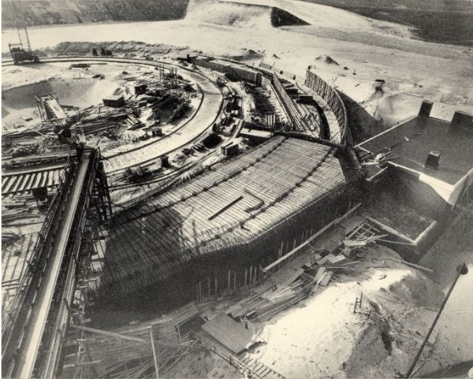
Round beams at Petra IV
Ilya Agapov
NOCO2017, Arcidosso, 19-22 September 2017

Slide 2
Contents
Petra IV – the Petra III upgrade project
Round beams on coupling resonance – experience at Petra III
Twist lattice
Nonlinear dynamics aspects in the twist lattice

Slide 3
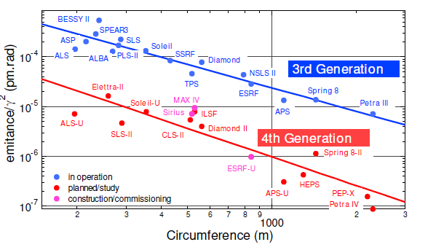
Petra IV
2.3 km circumference 1.6 km bending radius
10-30 pm emittance range from scaling of various MBA lattices possible
~10 pm diffraction limit at 10 keV in 2015 (20 keV in 2017)
From Liu Lin IPAC 2017

Slide 4
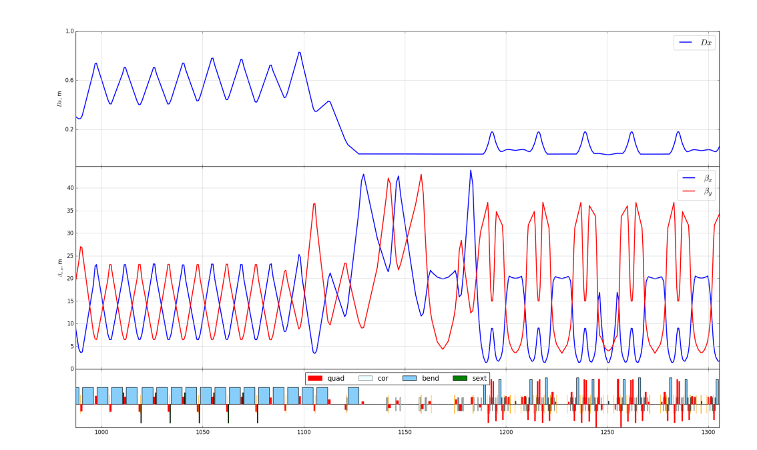
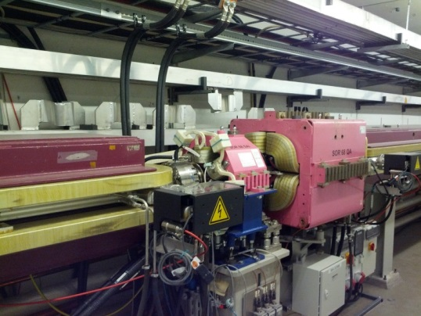
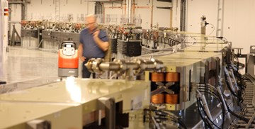
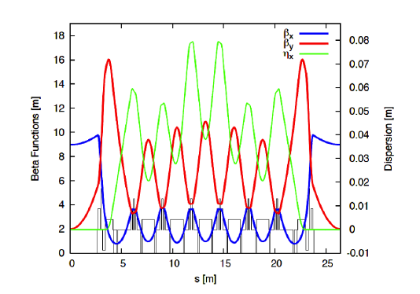
Petra IV
PETRA III DBA + FODO
Want to upgrade to MBA

Slide 5
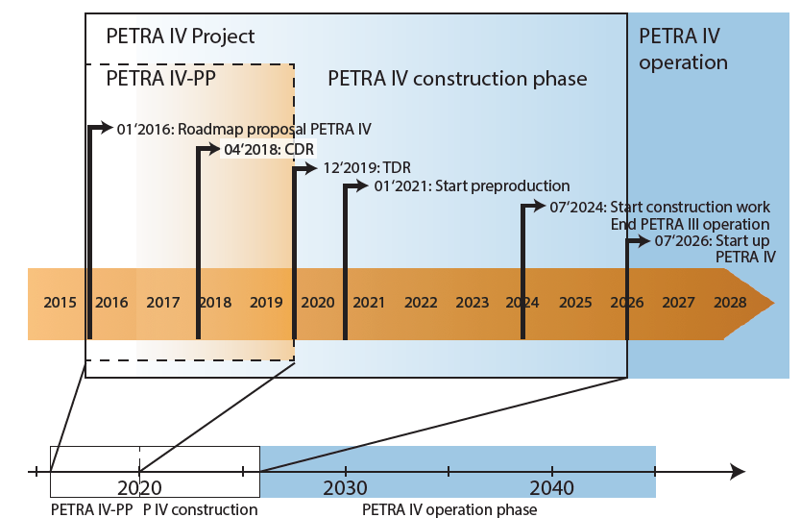
PETRA IV project study: time schedule

Slide 6
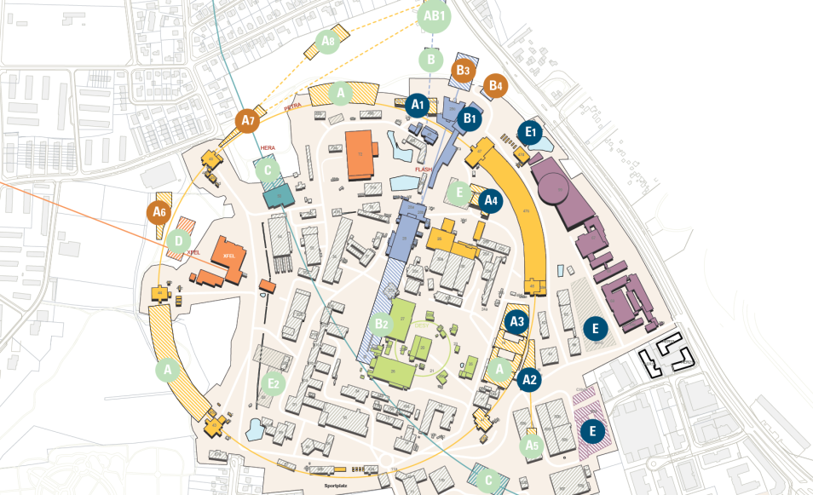
Petra IV challenges
Opportunities are challenges at the same time
Campus: existing infrastructure but not much freedom to build new exp halls; semi-underground tunnel
Long straights – long IDs, beam manipulation
Usual DLSR challenges
  Nonlinear dynamics
  Vacuum
  Magnet design
  Vibrations, stability, alignment
PETRA IV Parameter
Energy | 6 GeV (4.5 – 6 GeV)
Current | 100 mA (100 – 200 mA)
Number of bunches | ~ 1000
Emittance horz. | 10 pm rad (10 – 30 pm rad)
vert. | 10 pm rad (10 – 30 pm rad)
Bunch length | ~ 100 ps

Slide 7
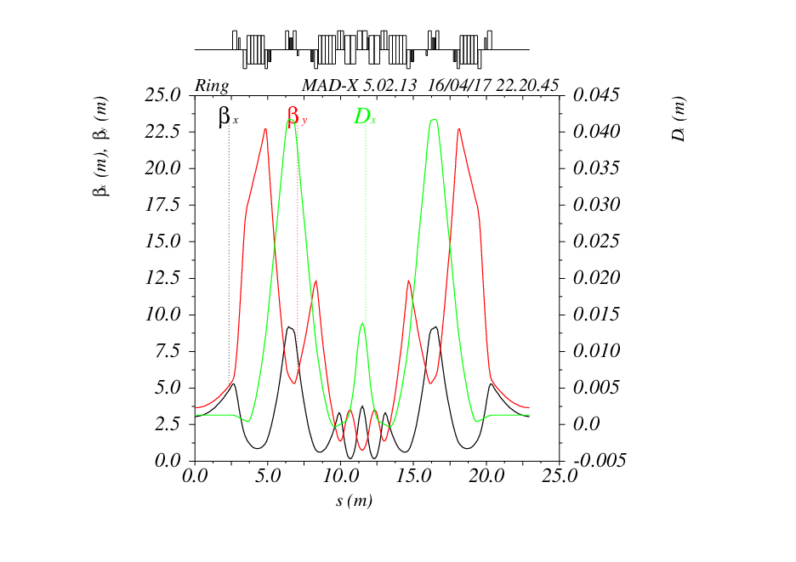
Petra IV lattice based on ESRF design
Different scaling/modifications applied to the ESRF-EBS cell
Scaling : if 1/f and g are the angle and length scaling factors, with appropriate magnet strength scaling same optics, emittance scales as 1/f³,DA as g/f²
  Option 1: 23m length., 5º. (9 cells arc, same ID pos.), ~10pm
  Option 2: ~29m length., 6.3º. (7 cells arc), ~24 pm
  Option 3: ~ 25 m, 5.6º. (8 cells arc) ~14 pm
Similar design, but with 6 bends (H6BA), can also give 24 pm
H6BA
H7BA

Slide 8
PETRA IV-Ring with H7BA 25.2 m cells and DW
Parameter | Value
Energy E | 6 GeV
Length L | 2304 m
Tune Q_{x}/Q_{y} | 163.17 / 67.27
Nat. chromaticity ξ_{x}/ξ_{y} | -228.8 / -190.9
Damping part. number J_{x} | 1.145
Nat. emittance ε_{x} | 9.3 pm*rad
MCF α_{c} | 0.015e-3
Energy spread σ_{e} | 1.425e-3
Hor. damping time τ_{x} | 17.3 ms
Ver. damping time τ_{y} | 19.8 ms
Long. damping time τ_{e} | 10.7 ms
Energy loss per turn U₀ | 4.6 MeV
β_{x} at ID | 6.6 m
β_{y} at ID | 2.1 m
D_{x} at ID | 0 m
Free space L at ID | 5.0 m
Damping
Wigglers
Injection
β_{x}=100 m
Long straight section in W: damping wigglers
Parameters: 10 DW, L_{DW}=4 m, B_{DW}=1.5 T, λ_{DW}=4.5 cm
Hor. beta peak of 100 m (“Injection”) in S
Phase advance in long (short) straights:
planes Δφ_{x,y}= 1(2) + q_{x,y}/8
Zero-current values – without IBS!

Slide 9
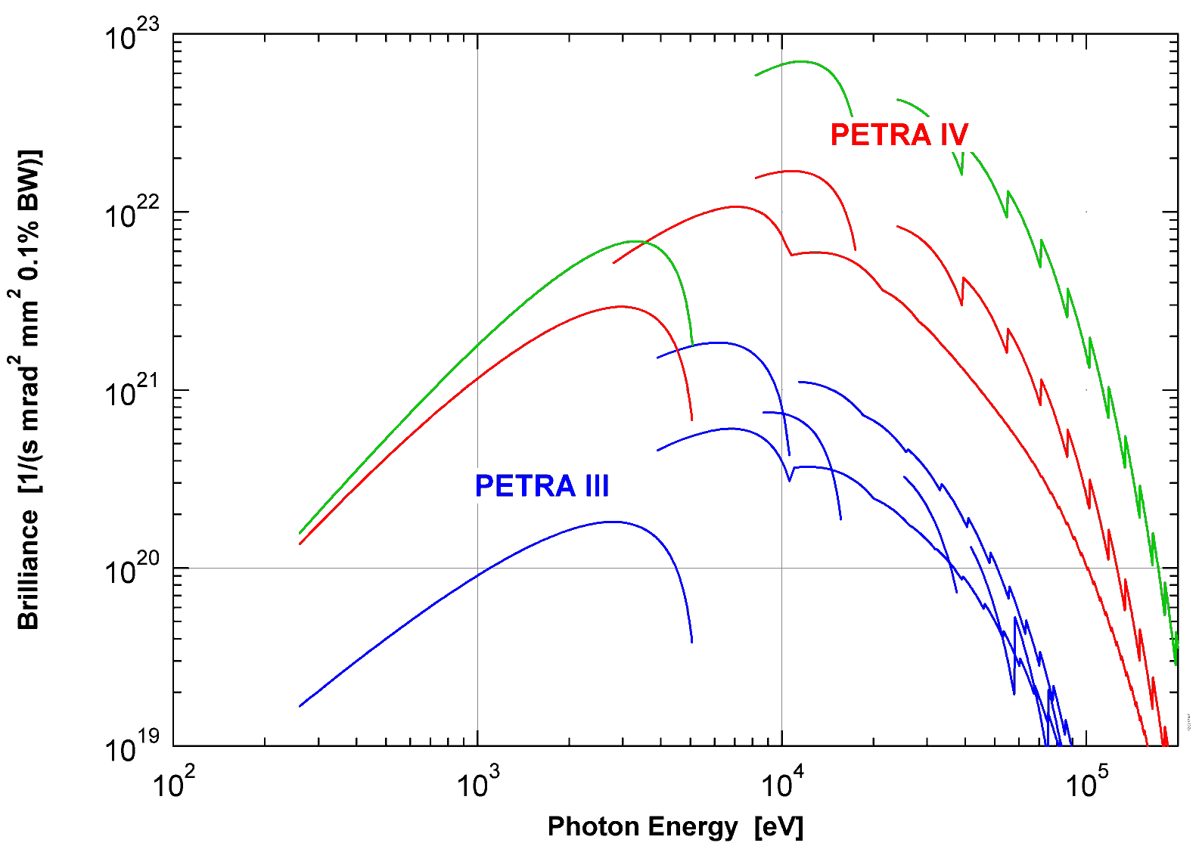
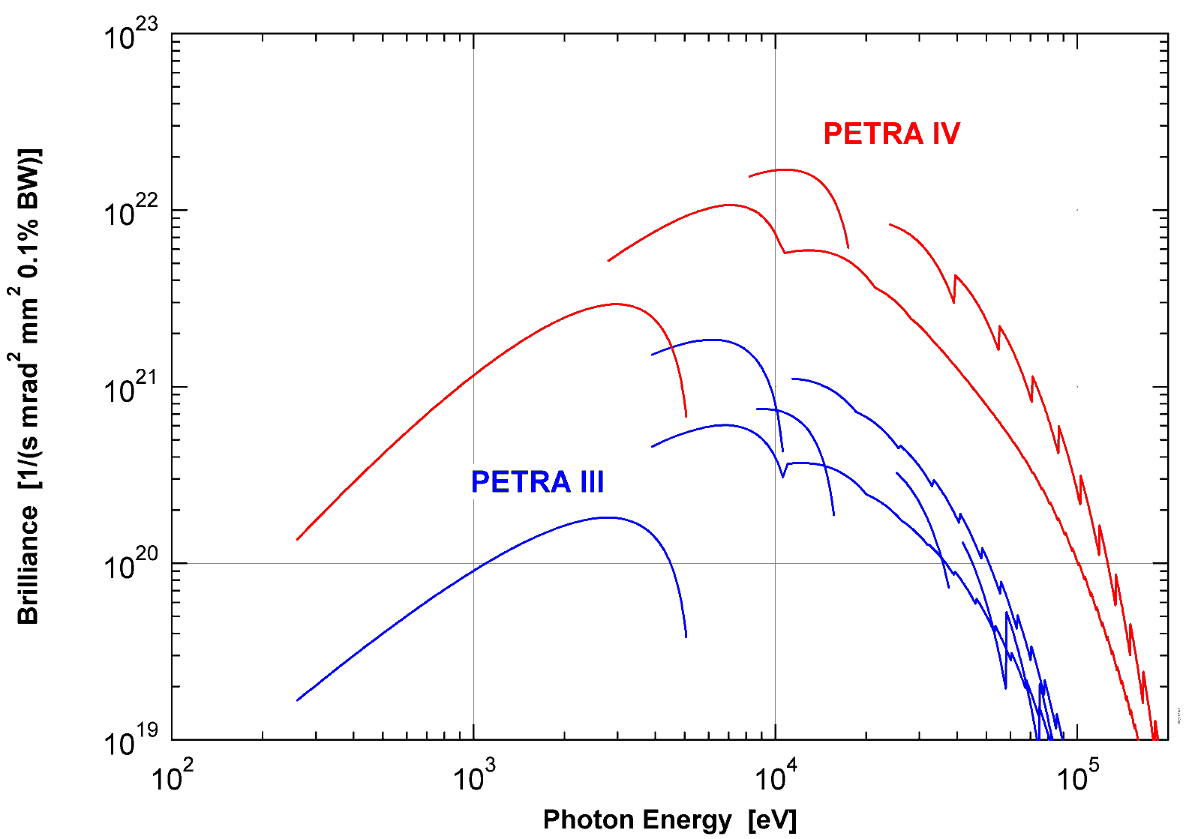
Brilliance Comparision
PETRA III
  ε_{x} = 1.2 nm,
  κ = 0.25%
PETRA IV
  ε_{x,y} = 15 pm round
  β_{x}=5m, β_{y}=2.5m
  ➔ increase by 100x
  at 80keV
CPMU_4m
U32_4*5m
U29_5m
IVU21_4m
PETRA IV
aggressive design
  ε_{x} = 10 pm
  κ = 50%
  β_{x,y} = 1m
UE65
all calculations for 6GeV

Slide 10
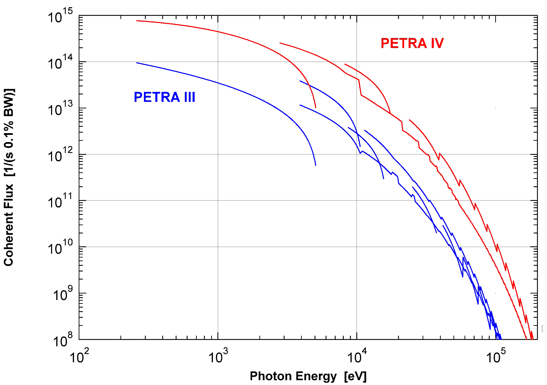
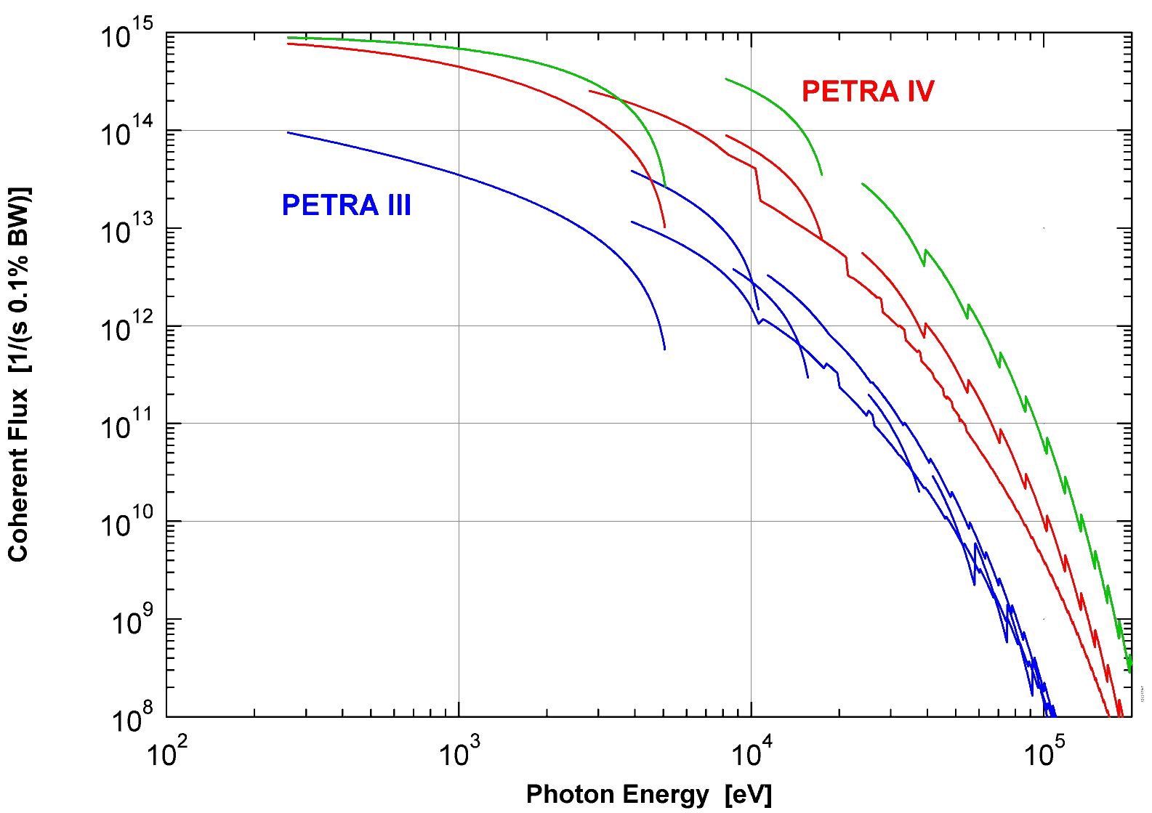
Coherent Flux Comparision
PETRA III
  ε_{x} = 1.2 nm,
  κ = 0.25%
PETRA IV
  ε_{x,y} = 15 pm round
  β_{x}=5m, β_{y}=2.5m
  ➔ increase by ~40x
  at 80keV
PETRA IV
aggressive design
  ε_{x} = 10 pm
  κ = 50%
  β_{x,y} = 1m
  ➔ increase by ~200x
  at 80keV

Slide 11
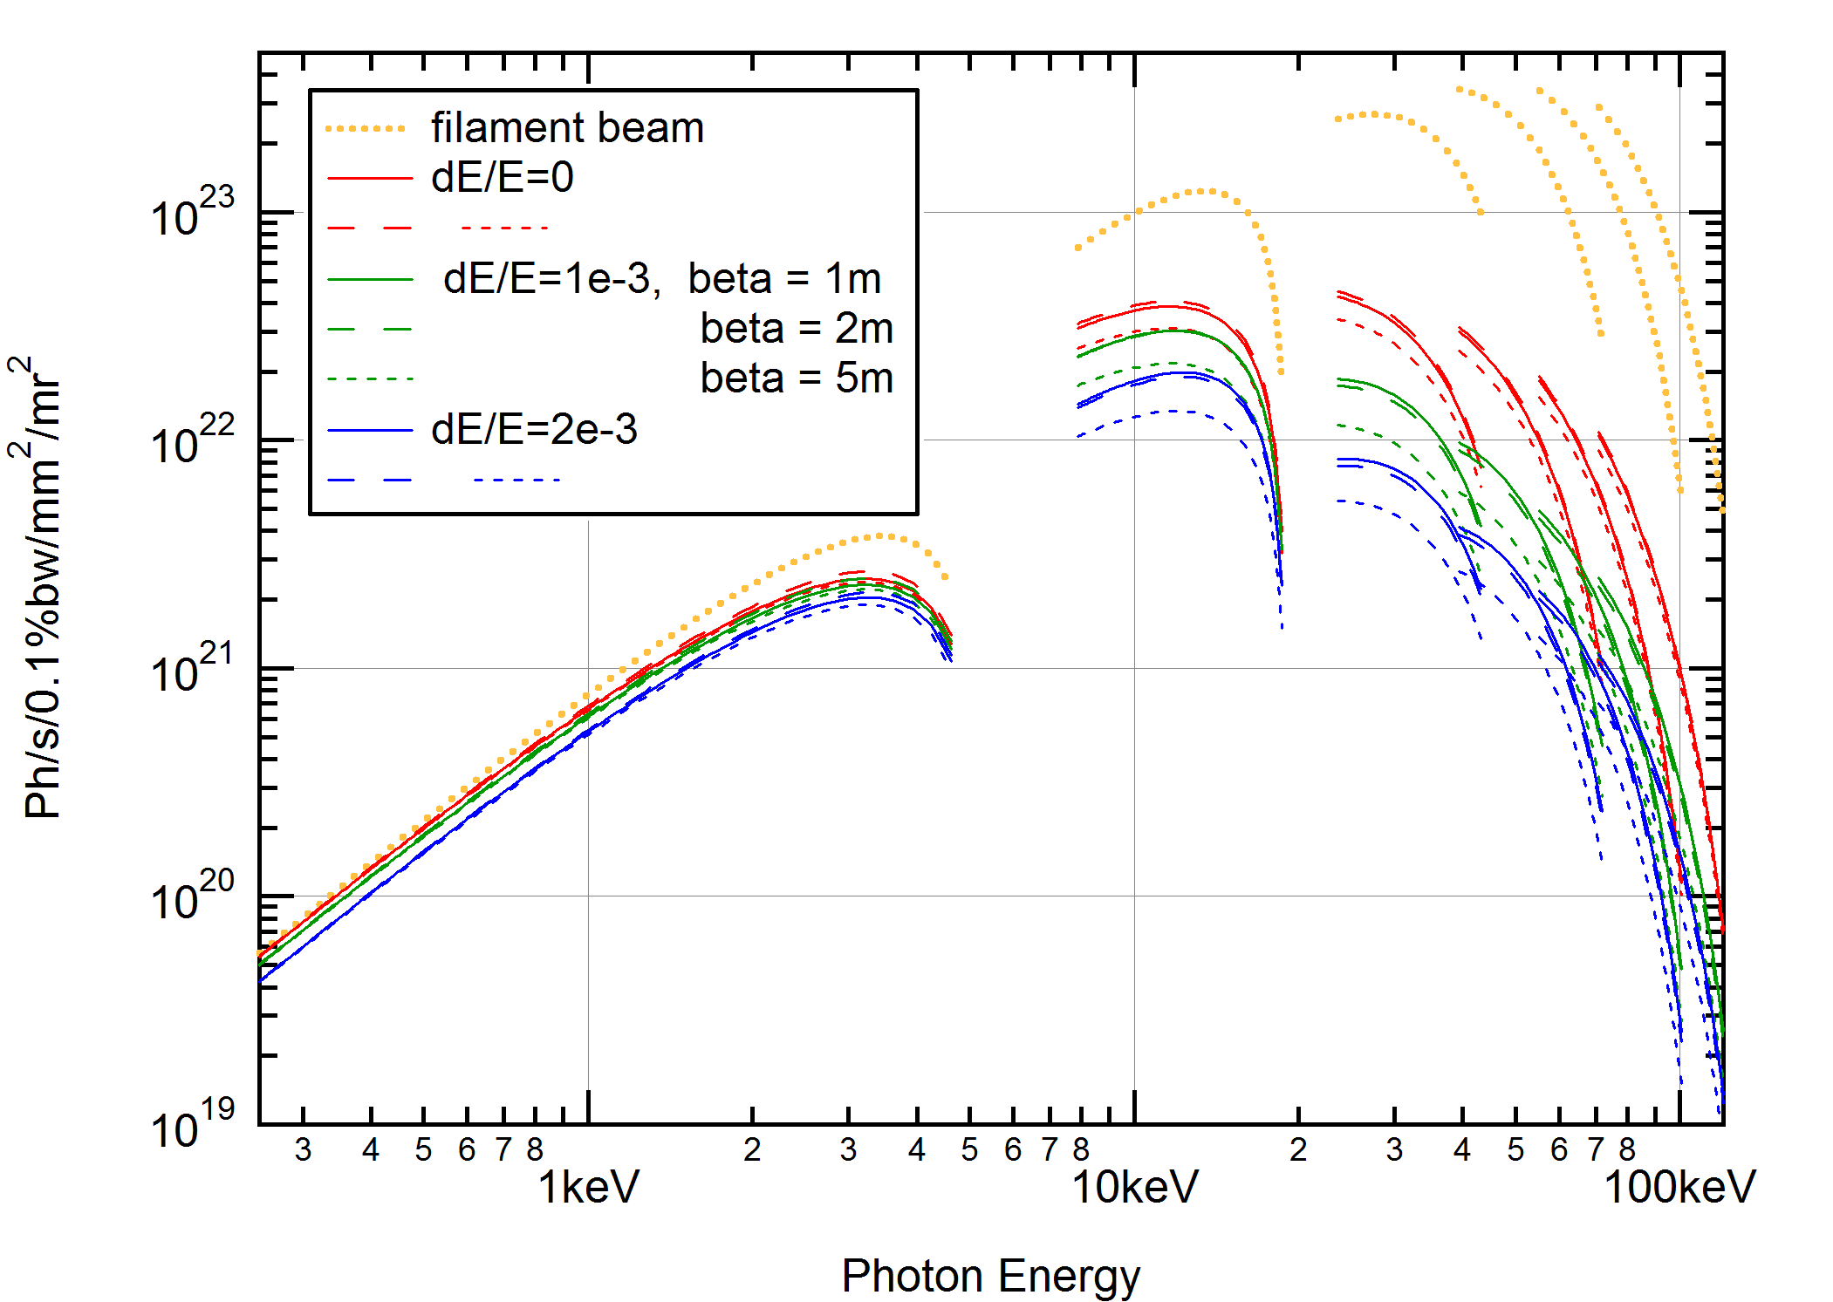
Effect of energy spread
Energy spread to be minimized – try to avoid damping wigglers
beta_x,y = 1m (solid), 2m (dashed), 5m (dotted)

Slide 12
Touschek Lifetime
2.5%
10 pm
2%
20 pm
1.5%
Simplified analytical model with averaged optical functions
For very small emittances Touschek lifetime will rise again
A larger momentum acceptance shifts the lifetime minimum to higher emittances
From Piwinski’s formula: For τ > 5 h in the range of 10-30 pm·rad a momentum acceptance of > 2% is needed
  Conditions: E = 6 GeV, round beam, N = 10¹⁰ particles in bunch
  <β_{x}> = 4.8 m, <β_{y}> = 8.9 m, <D_{x}> = 1.3 cm , σ_{s}=1 cm, σ_{p} = 10⁻³ (scaled ESRF-H7BA-cell)

Slide 13
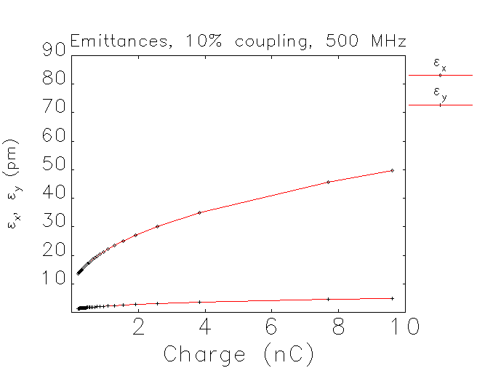
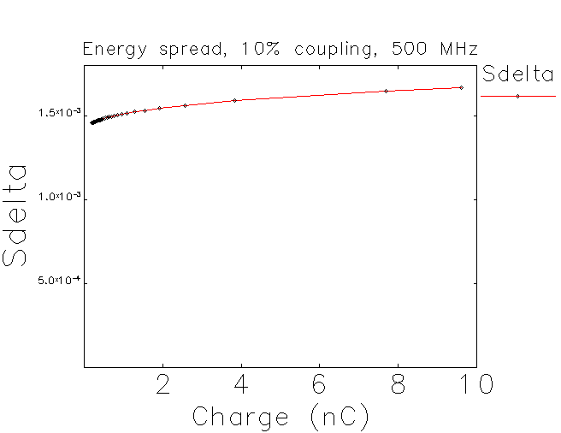
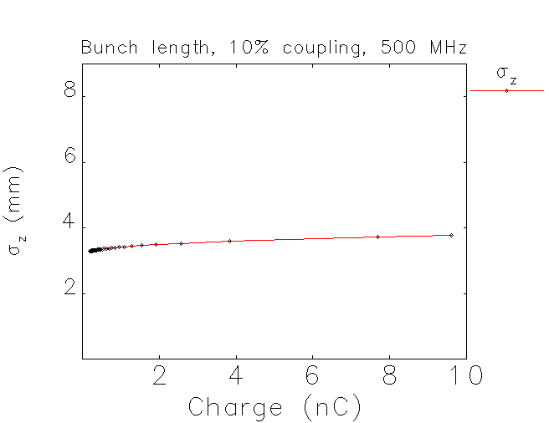
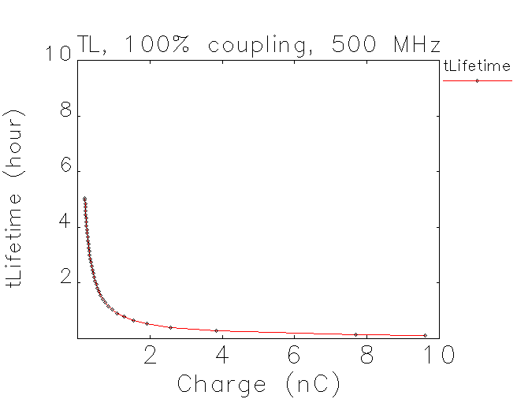
IBS and Touschek Lifetime (500 MHz, 10% coupling)
80 bunches
ε_{x}
Energy spread
is wiggler dominated!
960 bunches
Energy spread ≈1.5·10⁻³
Wiggler dominated
ε_{y}
3 mm → 13 ps

Slide 14
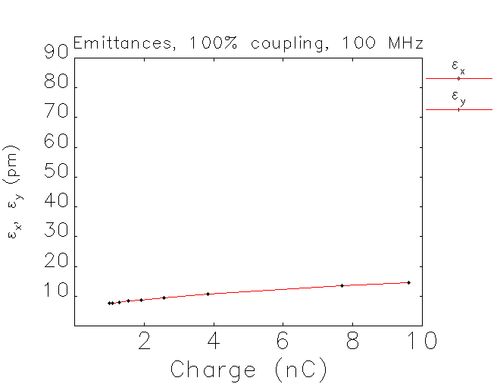
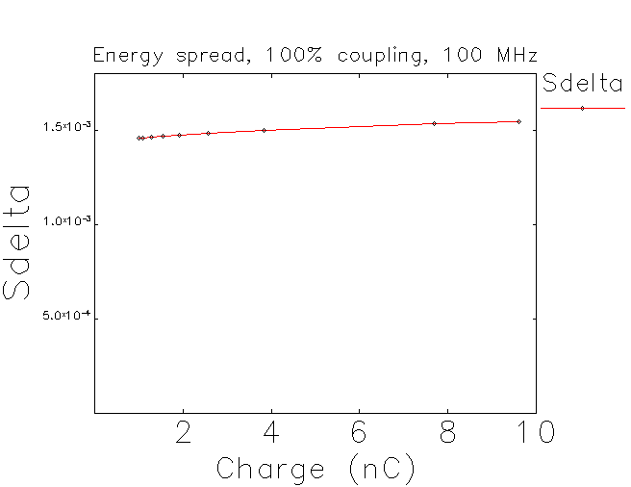
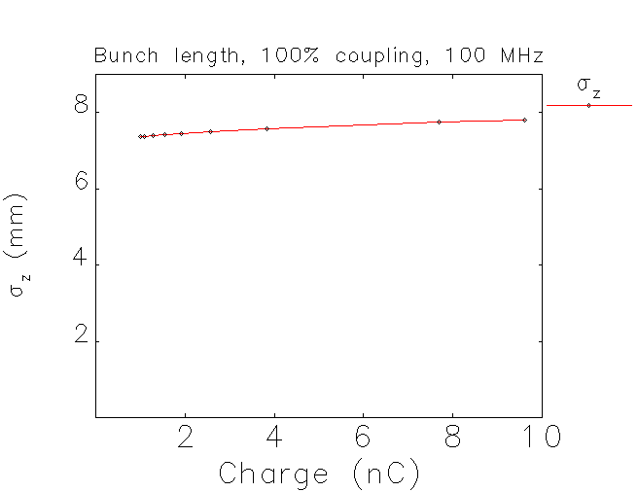
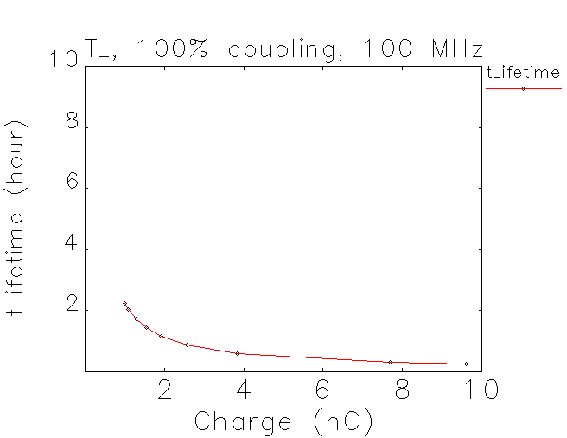
IBS and Touschek Lifetime (100 MHz, 100% coupling)
Energy spread
is wiggler dominated!
Energy spread ≈1.5·10⁻³
Wiggler dominated
80 bunches
768 bunches
ε _{x=}ε_{y}
7 mm → 23 ps

Slide 15
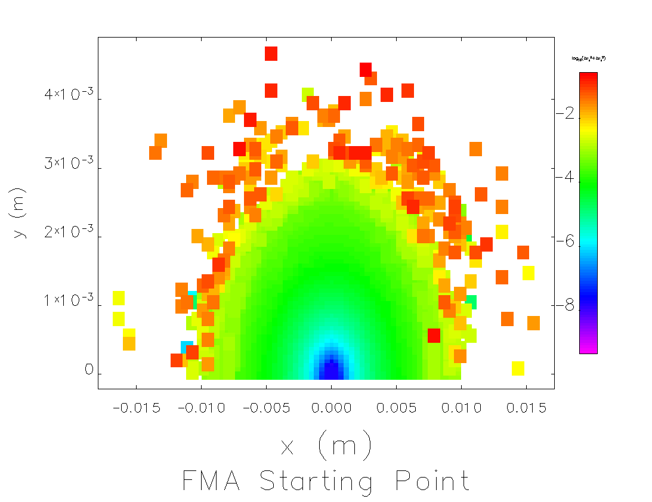
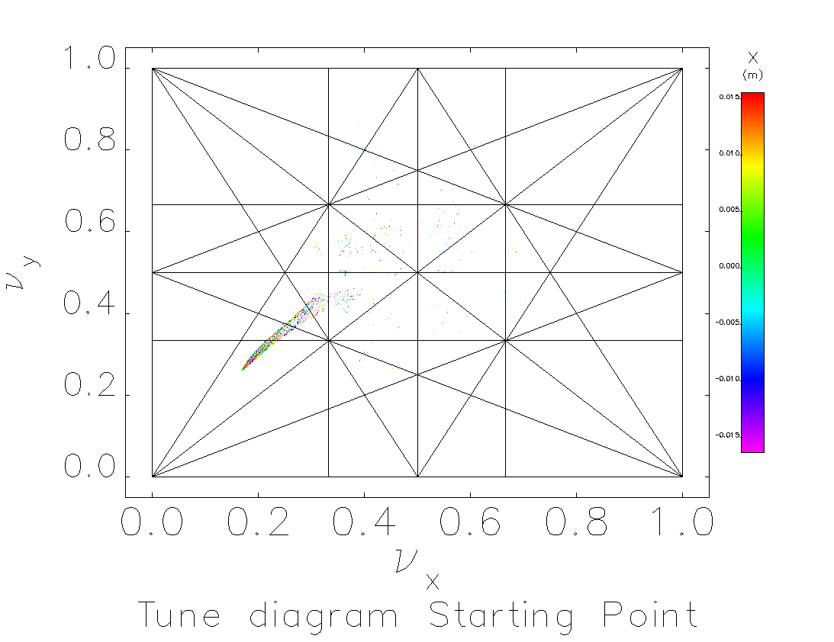
Petra IV reference lattice open issues
DA ~ 1 mm mrad w/o errors – 1cm at injection point. Trying to improve
Alignment tolerances very tight (few mu m rms)
Magnet strengths to be reduced (sextupole)
MOGA extremely cpu and time-consuming

Slide 16
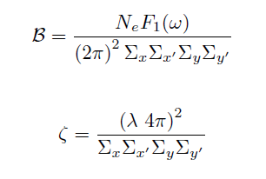
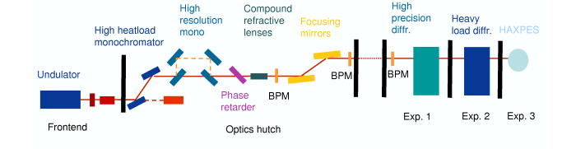
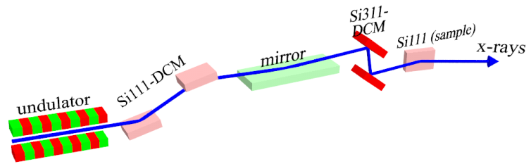
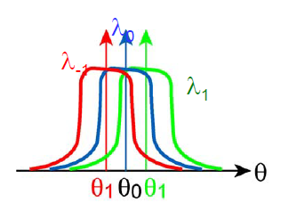
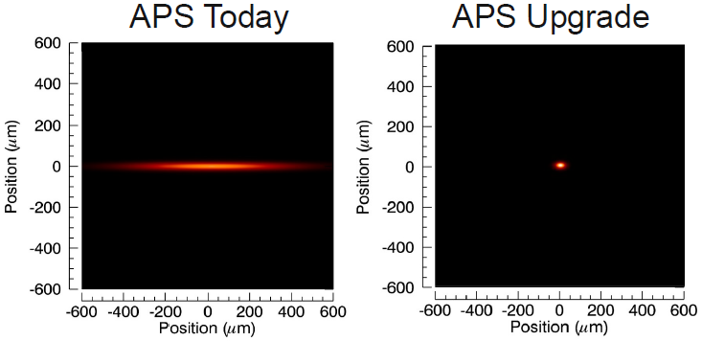
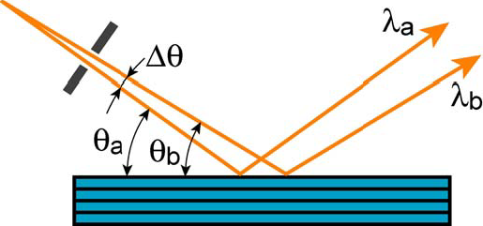
Round beams
Some applications could benefit from round beams
Smaller IBS growth rates
But:
Brightness counts
Beamline optics counts
P09
benchmark optics
Matsushita http://cheiron2010.spring8.or.jp/

Slide 17
Round beams -- methods
Wigglers
Coupling
  Resonance
  Moebius and modifications (Novosibirsk, Cornell, PSI,…)

Slide 18
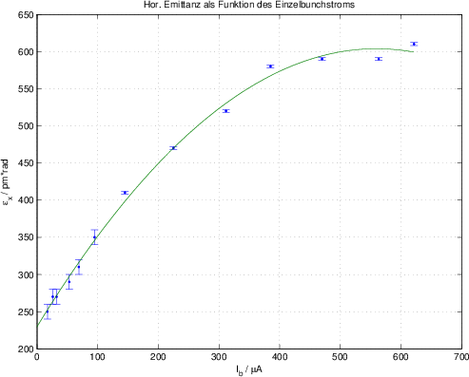
Petra III
Bringing tunes to coupling resonance routinely for coupling correction
IBS measurements at 3 GeV in 2013
Recent campaign – try to achieve operational parameters with round beam
3 GeV measurement
Jan 2013

Slide 19
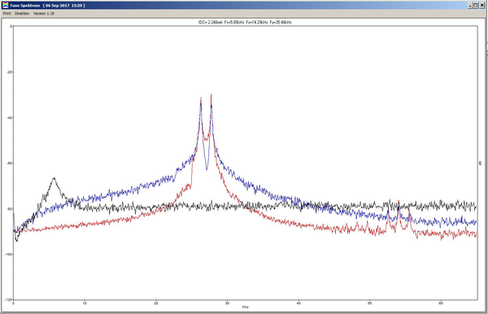
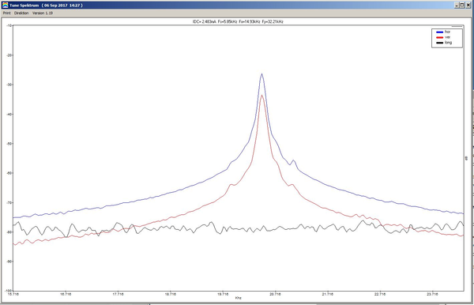

Petra III details on coupling resonance
Emittance ratio Guignard Phys. Rev, E 51, 6 1995
g =$\frac{{\left(\frac{C}{∆}\right)}^{2}}{{\left(\frac{C}{∆}\right)}^{2}+2}$
24.6 kHz (Qx=Qy=0.19)
Separation 2kHz = 0.01
20.45 kHz (Qx=Qy=0.157)

Slide 20
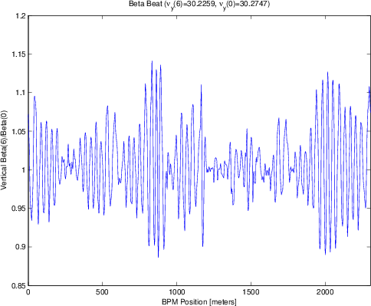
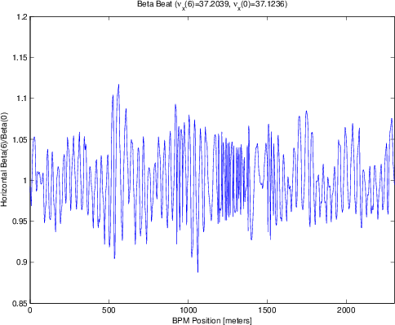
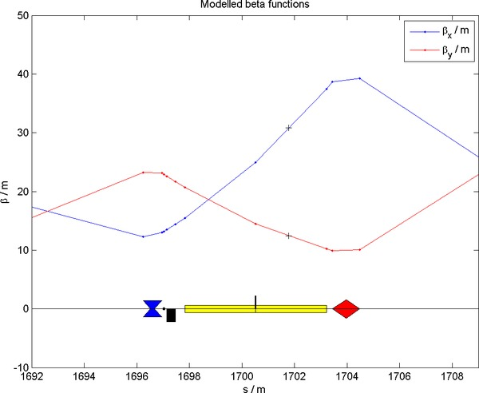
Petra III details on coupling resonance
Operational considerations on resonance
Need to correct and measure optics (dispersion, BB) – more difficult on resonance
If coupling is well corrected – resonance narrow, intensity drop moves tune away
Resonance broad – getting vertical dispersion; Balance to be understood
Need to figure out optimal injection scheme (e.g. inject close to resonance, broaden with skew)
BB measurement with LOCO – 10% BB at source
Unfortunately works only on a neighbouring tune

Slide 21
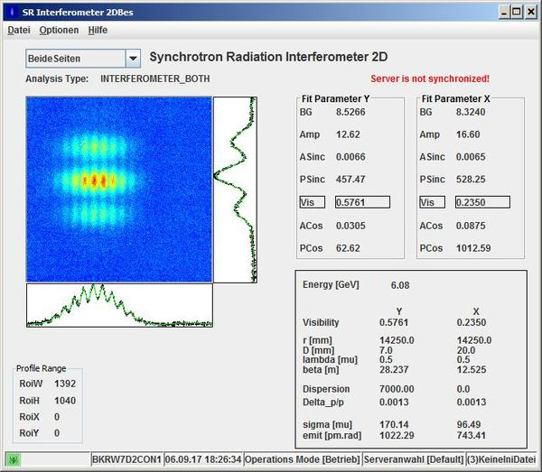
Petra III details on coupling resonance
Results
Getting round beam within 10-20% measurement uncertainty
Approx. half emittance (down to 800/700; flat beam ~1500/15 ) only close to the original WP. At tunes around 0.24 getting vertical emittance blowup without reduction in hor.
Store 2.7 mA per single bunch (same as present high charge mode)
TODO: optimize working point, try to store 100 mA
Top-up probably impossible
2D interferometric system:
A. Novokshonov et al., proc IPAC 2017
A. Novokshonov et al., proc IBIC 2016

Slide 22
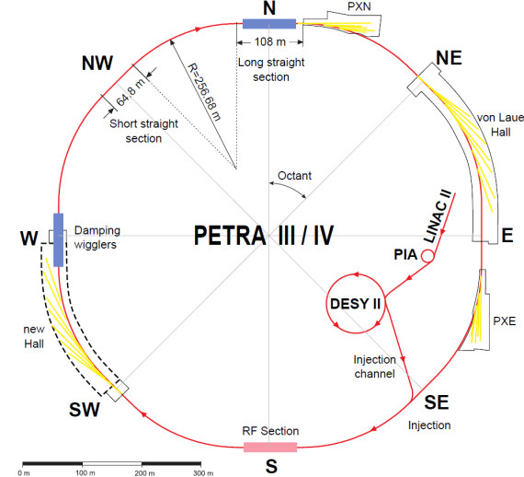
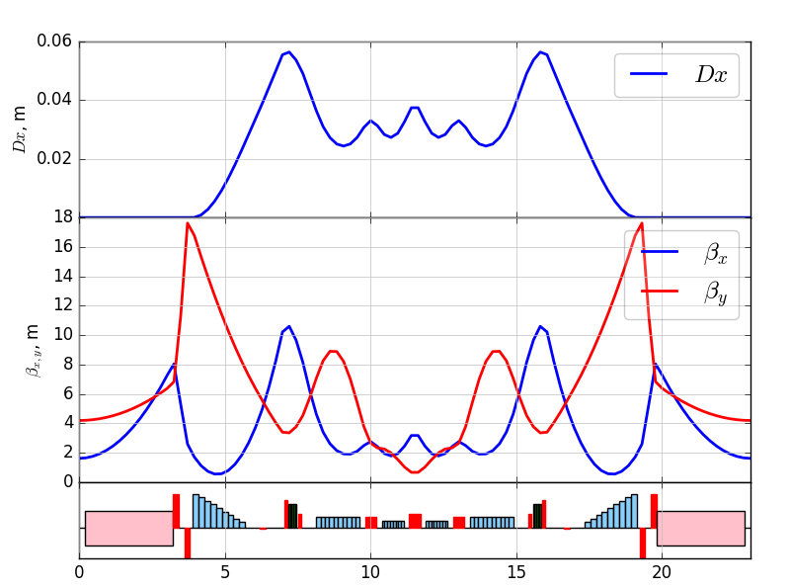
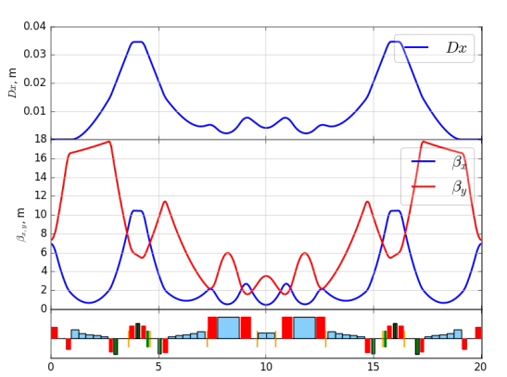
Other lattices for Petra IV – exploiting geometry
Hybrid 7BA lattice used for CDR studies
However with 6/8 arcs having no IDs this is not optimal
Looking into alternative lattices

Slide 23
Twist lattice
A lattice based on following concepts
Non-interleaved sextupole scheme
Non-local chromaticity correction
Phase space exchange (Twist)

Slide 24
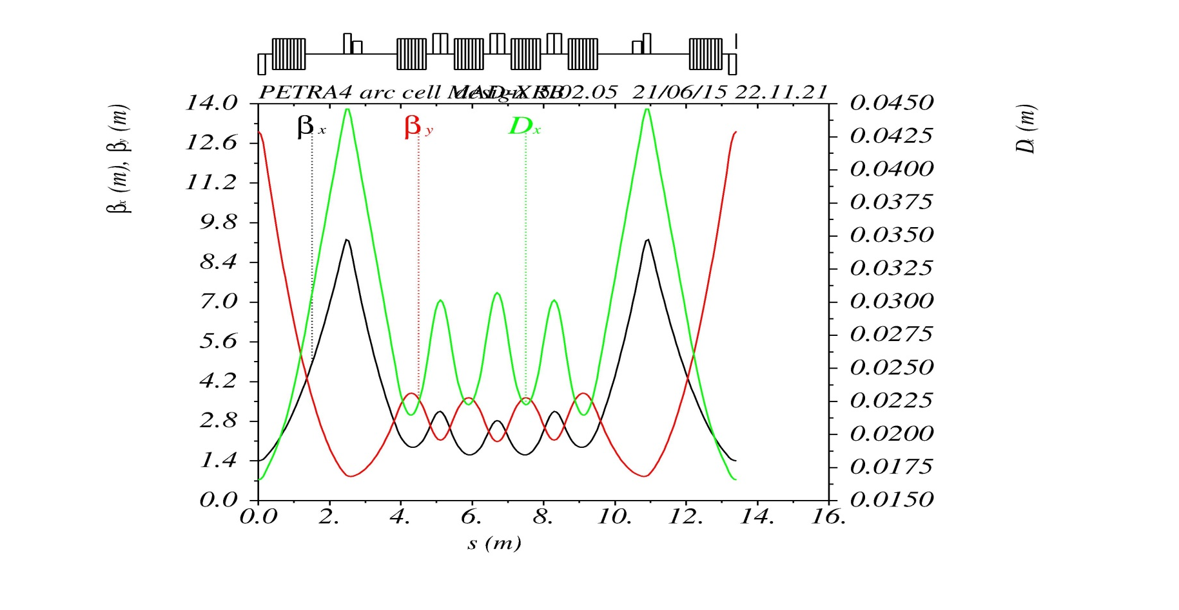
Phase space exchange optics (TMBA)
Concept to significantly improve DA (suggested for Petra R. Brinkmann Ideenmarkt 2015)
Two phase space exchanges in the ring (similarity to Möbius scheme, but optics is always in one mode locally)
Only sum chromaticity is corrected, allows to have a –I sextupole arrangement
SF
SF
y/x
ΔΦ_{x,y} = π
part 2
3 arc octants
y=hor., x=vert.
3 arc octants
injection section
undulator sections
x = hor., y = vert.
part 1
x/y
Phase space exchange (twist)

Slide 25
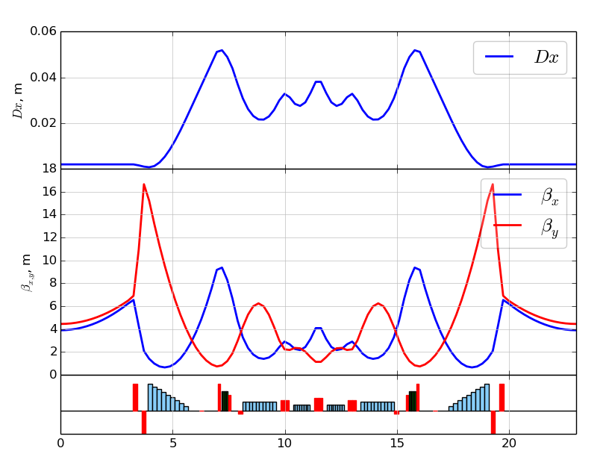
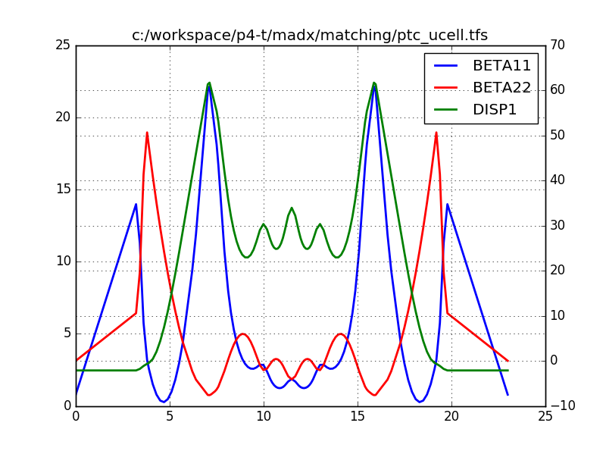
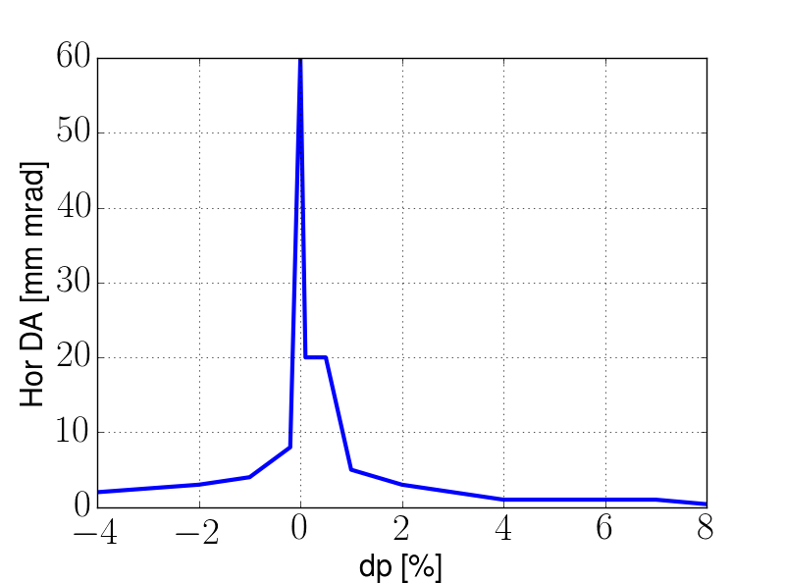
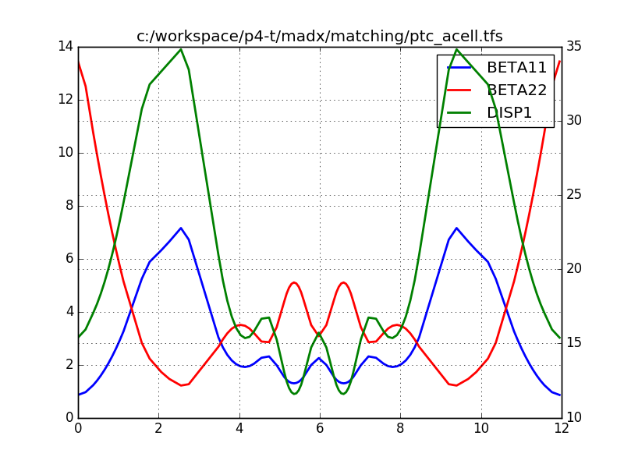
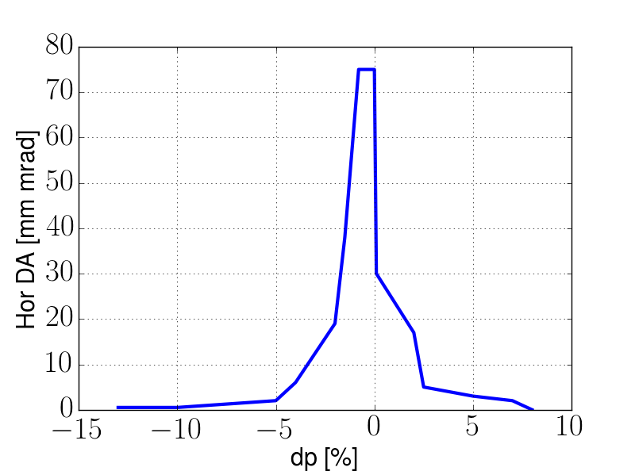
TMBA cells
Cells for arcs with and w/o IDs, 1 sextupole family, with π/π phase advance (-I transform)
Can be used in combination with non-local chromaticity correction (2 cells, arc, ring etc.)
H7BA cell with one sextupole family can be used in the same way
Cell layout, emittance range 35-50 pm
Extra large on-momentum acceptance
Cell with no ID space based on same principle, emittance range 25-30 pm

Slide 26
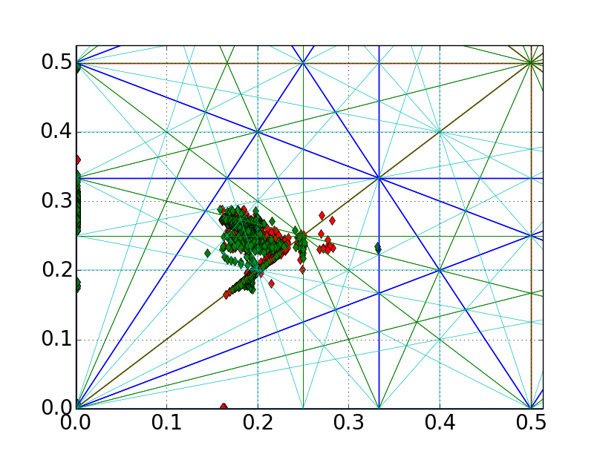
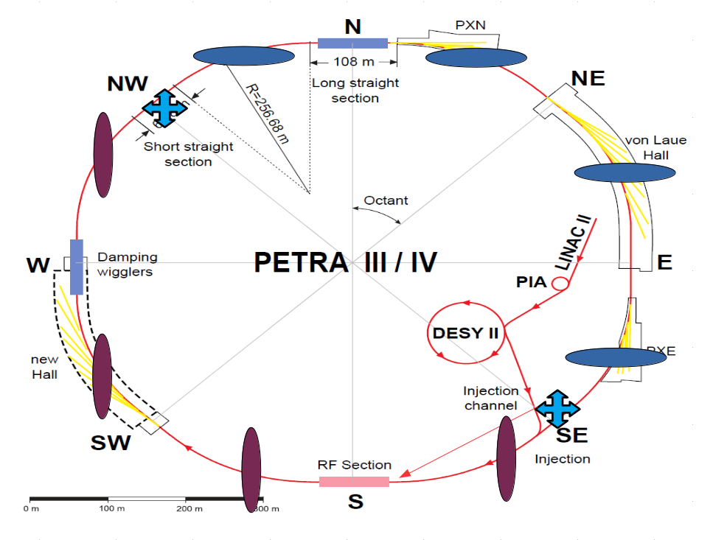
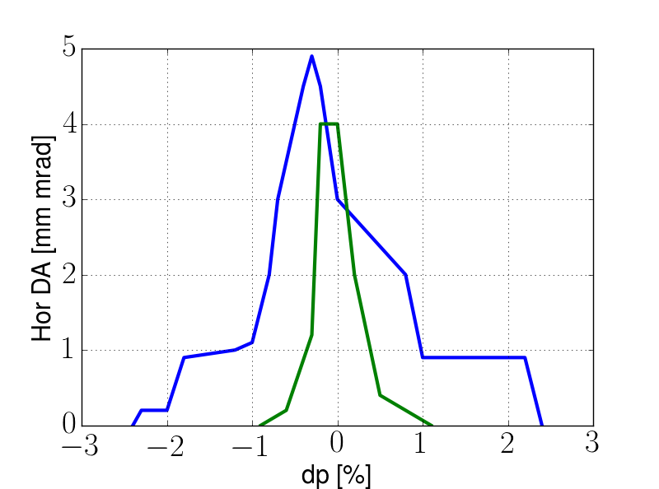

TMBA optics
Version 0 -I 6BA no-ID arc cells, versions 1 and 2: -I 6BA no-ID arc and undulator cells
2-fold symmetry broken by injection region – superperiod 1
v1-v3 with two cell types
25/25 pm lattice
v0 (blue): only no-ID cell, 2 twists, 8 straights tracking with RF
v2 (green): added undulator cell and injection point

Slide 27
TMBA optics features
On-momentum DA no problem. Limitation– path lengthening excites synchrotron oscillations – limited by longitudinal acceptance
2nd and higher order chromaticity limiting MA – not very different from the reference lattice
Optics has larger DA and smaller MA than HMBA. Work in progress to improve MA
Off-axis injection still non-trivial, but at least the oscillations are controllable and can be adjusted to the aperture
Ideally one would want to have the twist optics as and advanced option

Slide 28





Simplified model with two arcs (no twist)
Test, 10xcell B per arc
q1 q2 dq1 dq2
0.1702368928 0.2135912064 0.7212729468 0.8111877208
Footprint for momentum deviation, MA +-5 % (x0=y0=1 mu m)
Tracking vs analytical(ptc) up to 5th order

Slide 29




Toy model nonlinear dynamics gallery
Model: Matrix x Twist x Sextupole1 x Matrix x Twist x Sextupole2
0-aplitude tune close to 1/3 resonance

Slide 30




Toy model nonlinear dynamics gallery
Large amplitude stability destroyed by phase detuning order 10^-2
Close to ¼ resonance – trajectories irregular for much smaller amplitudes

Slide 31






Toy model : Phase space with and w/o twist
Close to ¼
On and close to 1/3

Slide 32


Toy model
No twist stability diagram x=y=0.5
Qx/2
Qy/2
With twist stability diagram x=y=0.5 Similar pattern for other initial conditions

Slide 33




Toy model nonlinear dynamics gallery
DA example, 0.1/0.1 phase advances
twist
DA example, 0.32/0.32 phase advances

Slide 34
Conclusion
Petra IV lattice design is underway, with 10 pm H7BA 25m cell optics as current reference
Round beams could be and important option
Working on the coupling resonance is possible
Twist lattice investigated.
Simplified model of the twist lattice suggests that the dynamics with a twist can be more sensitive to the phase advance selection
However the twist allows for –I sextupole scheme which cancels out many nonlinearities
Coupling-based round beam schemes are poorly compatible with off-axis injection
Acknowledgements:
Used contributions from R. Brinkmann, X. Nuel Gavalda, J, Keil, M. Tischer, R. Wanzenberg

